Slide 1
TBD: a good title
library(dplyr)
rladies_global %>%
filter(city == 'Your city')

Slide 2

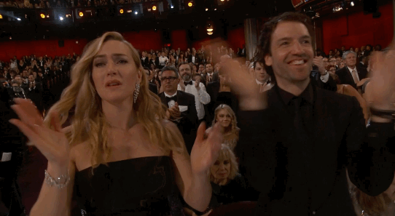
Who am I?
By day: CRM Analyst @ Hotels.com, crunching numbers
By night: theatre enthusiast (not) going to plays

Slide 3
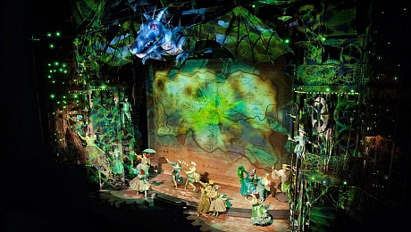
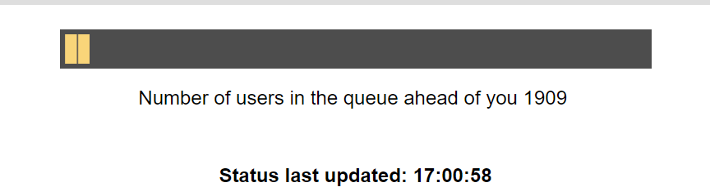
My theatre experience in London
Either too expensive
Or too popular
Or too hard to understand
As a solution: every time we have to go to Budapest or something else, we try and book a ticket for a play in our favourite theatre.
Question: if we decide late when to go home, which are the plays which will not be sold out?

Slide 4
Approach
1
Scrape the website periodically to figure out which play is sold out when
2
Collect information about the plays to have some features to work with
3
Build a simple model

Slide 5
Scrape the website periodically
1
library(rvest)
url_root <- "http://katonajozsefszinhaz.hu/jegyek"
webpage_root <- read_html(url_root)
for(i in 1:length(plays_titles)) {
print(i)
current_date <- html_text(html_node(webpage_root,
paste0('tr:nth-child(', i,') td')))
current_location <- html_text(html_node(webpage_root,
paste0('tr:nth-child(', i, ') td:nth-child(2)')))
…
}

Slide 6
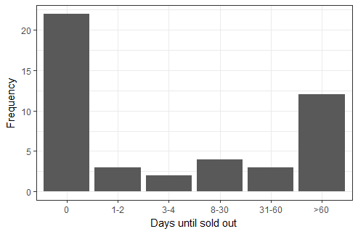
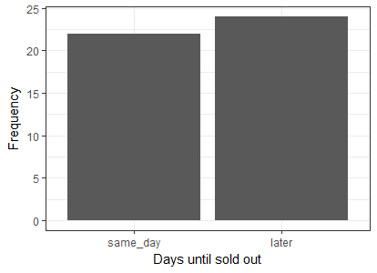
Feature engineering
2
Artists (actors, directors, etc.)
Price of the cheapest and most expensive ticket
Number of events per month
Number of events in the first and the second half of the month
Year of the premiere
Location

Slide 7
Model building
3
library(h2o)
classes <- read_csv("data/classes.csv")
…
h2o.init()
train <- full[1:30, c(1, 4, 5, 6)]
test <- full[31:46, c(1, 4, 5, 6)]
y <- "day_category"
x <- setdiff(names(train), y)
train <- as.h2o(train)
test <- as.h2o(test)
aml <- h2o.automl(x = x, y = y,
training_frame = train,
leaderboard_frame = test,
max_runtime_secs = 30)
aml@leaderboard
aml@leader
aml@leaderboard
aml@leader
train$predicted <- h2o.predict(aml@leader, train)[, 1]
test$predicted <- h2o.predict(aml@leader, test)[, 1]

Slide 8
Conclusion

Slide 9
Little guide
EDIT IN GOOGLE SLIDES
Go to the File menu and select Make a copy.
You will get a copy of this document on your Google Drive and will be able to edit, add or delete slides.
COLOR PALETTE
#181818
#D3D3D3
#88398A
#FFFFF
#562457

Slide 10
You can also split your content
White
Is the color of fresh snow.
Purple
Is the color of purple.

Slide 11

Hello!
I am the best R-Lady
I am here because I’d love to show you something. I work in some awesome company. You can find me at @username.

Slide 12
1.
Transition headline
Let’s start with the first set of slides

Slide 13
As Obi-Wan Kenobi may have said in Star Wars: “Use the source, Luke!"
—Barry Rowlingson
(answering a question on the documentation of some implementation details) R-devel (January 2010)

Slide 14
This is a
slide title
Here you have a list of items
And some text

Slide 15
BIG CONCEPT

Slide 16
In two or three columns
Column 1
First column.
Column 2
Second column.
Column 3
Third column.

Slide 17
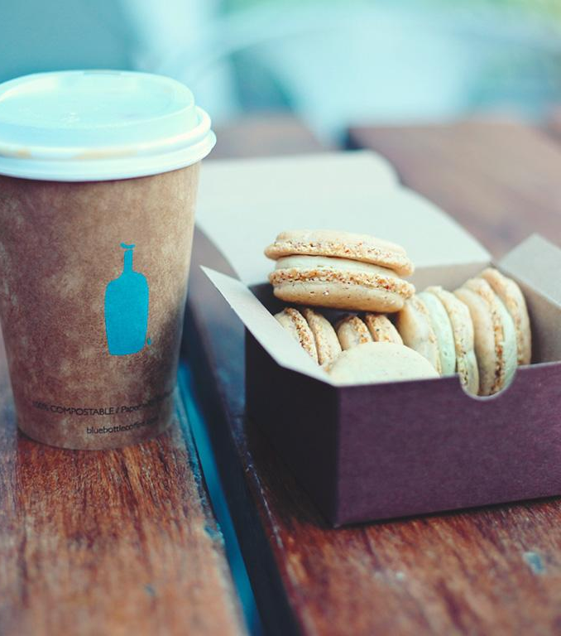
A picture is worth a thousand words
Nice image!

Slide 18
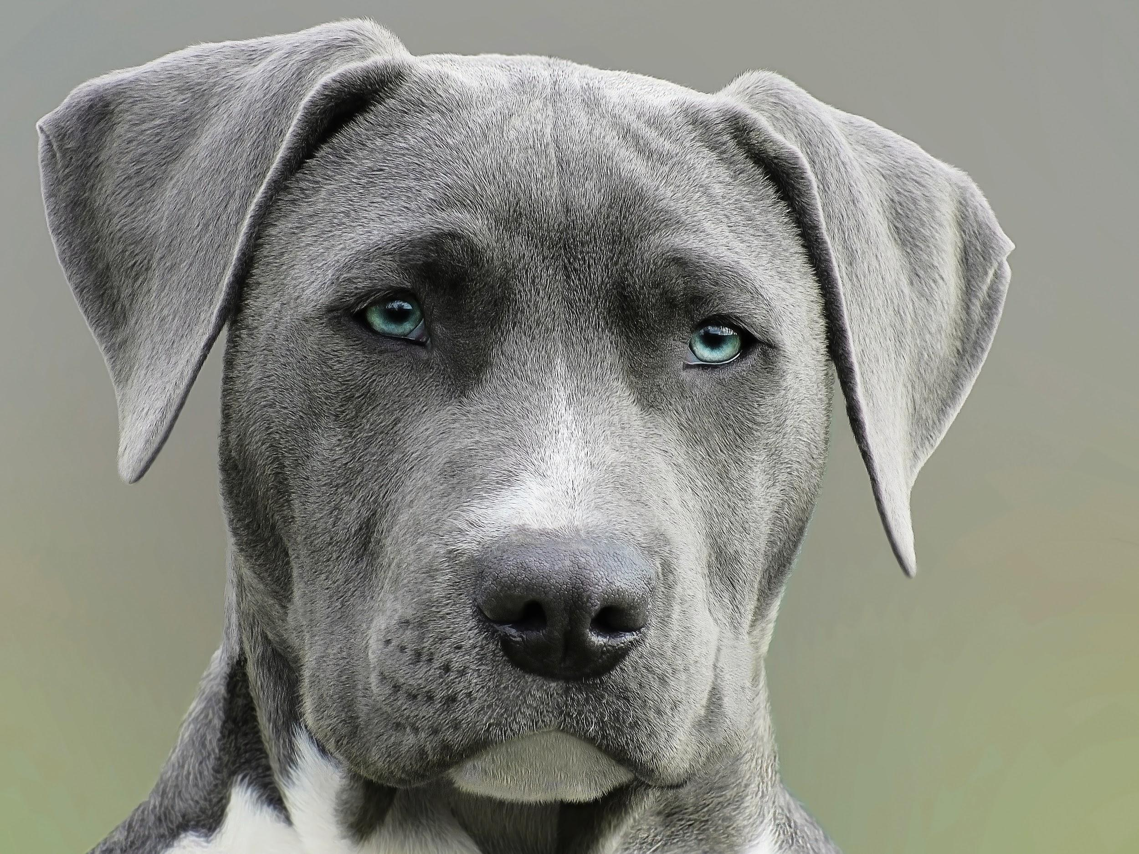
#rdogladies

Slide 19
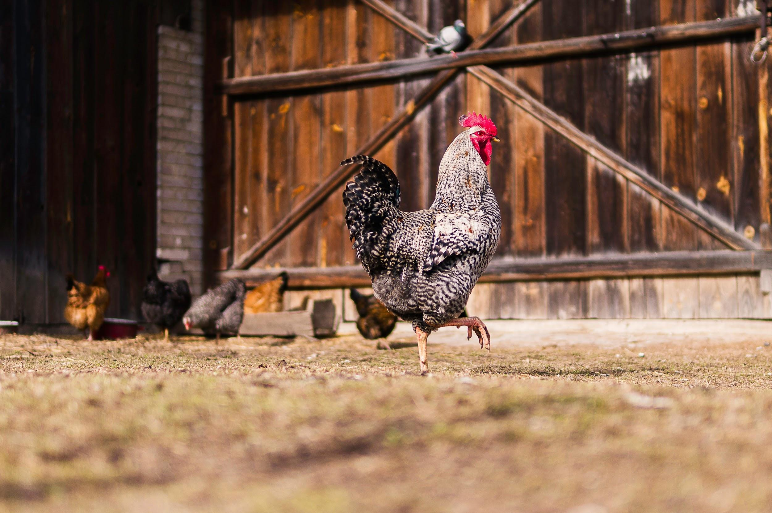
#rchickenladies

Slide 20
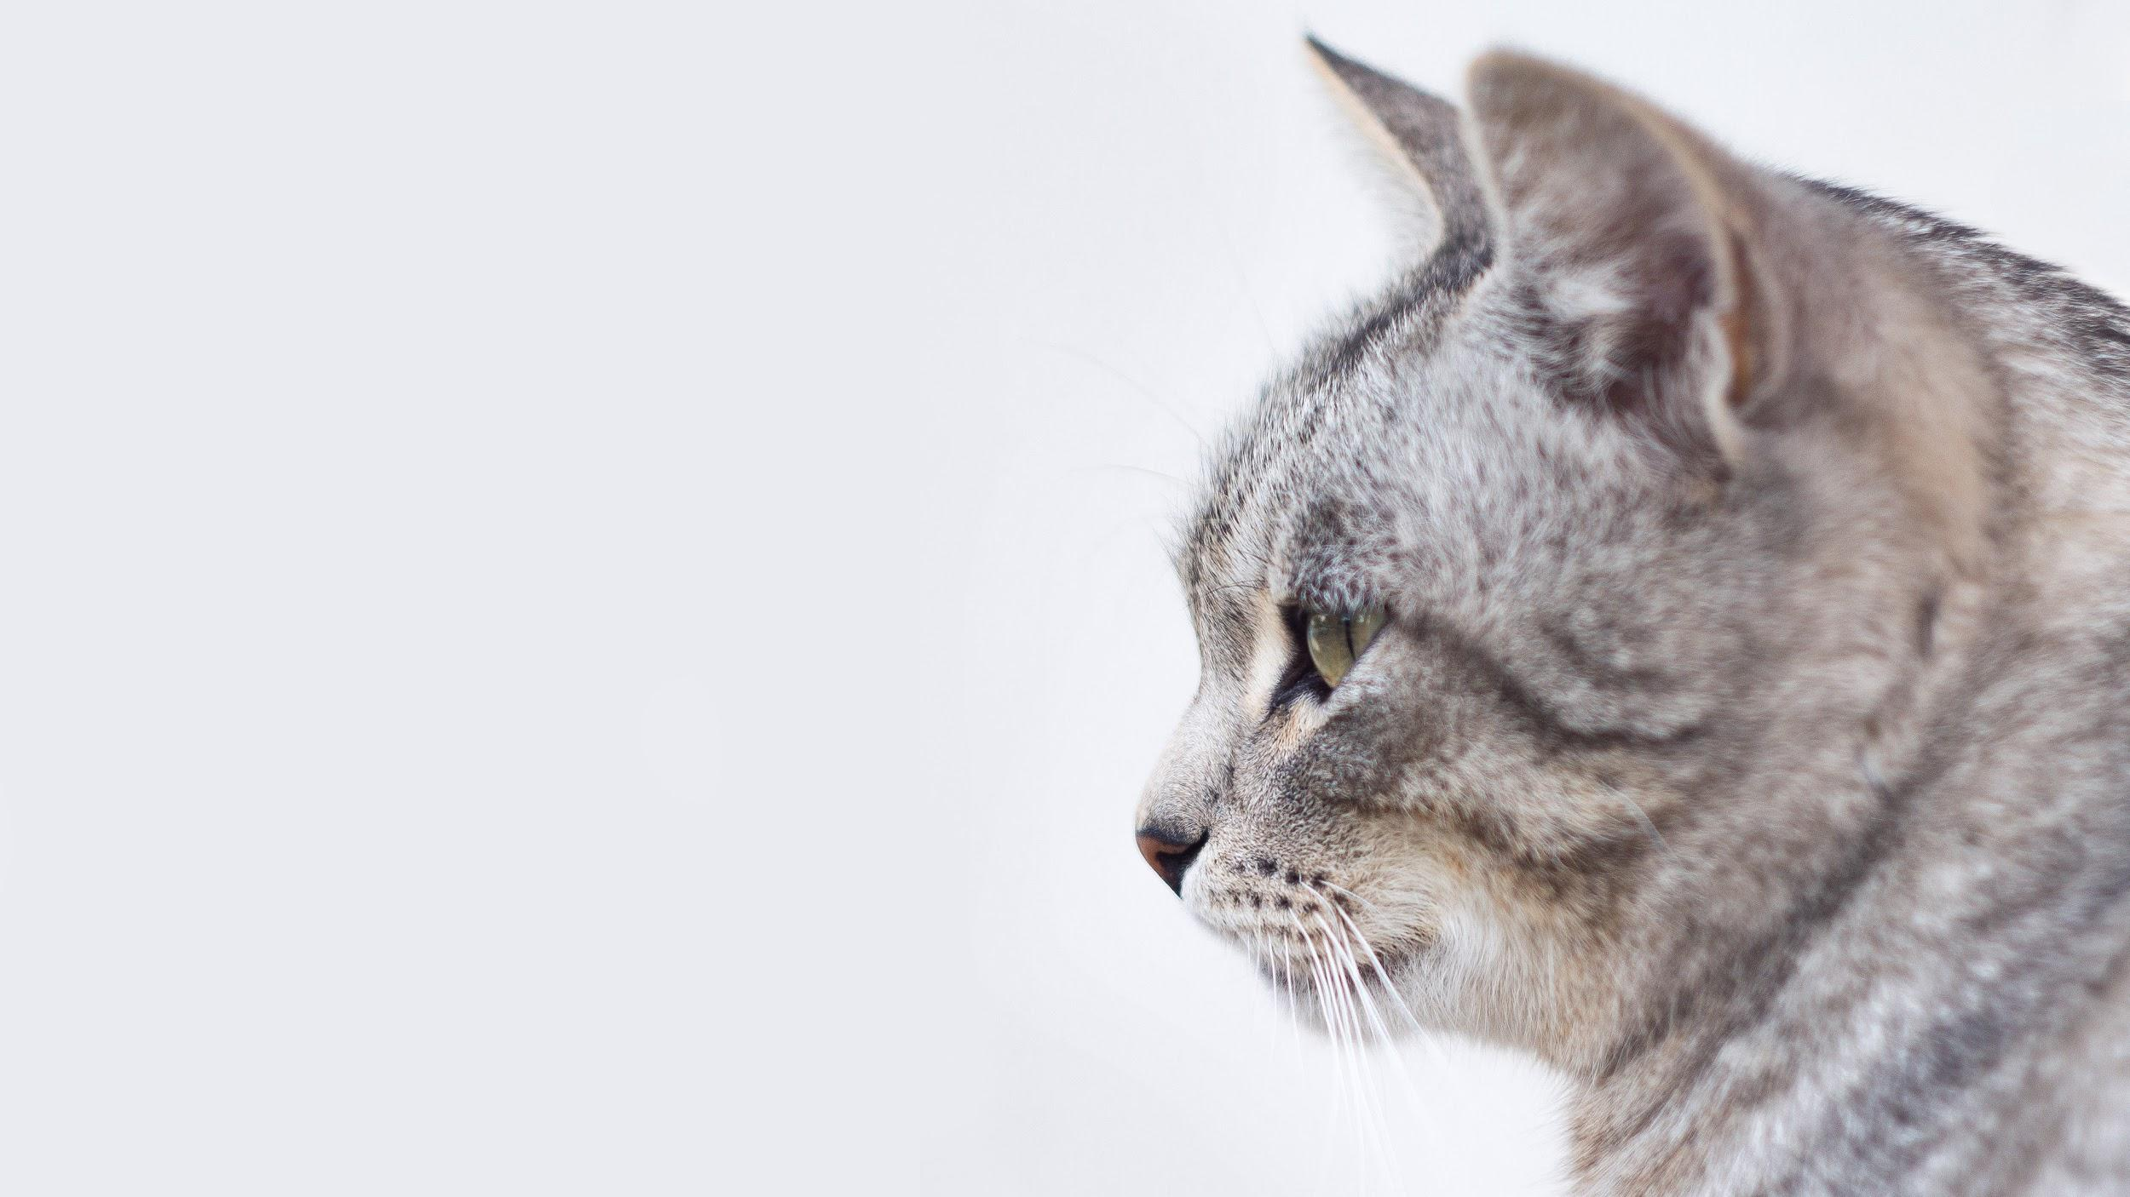
#rcatladies

Slide 21
This is how your charts could look
Purple
White
Purple

Slide 22
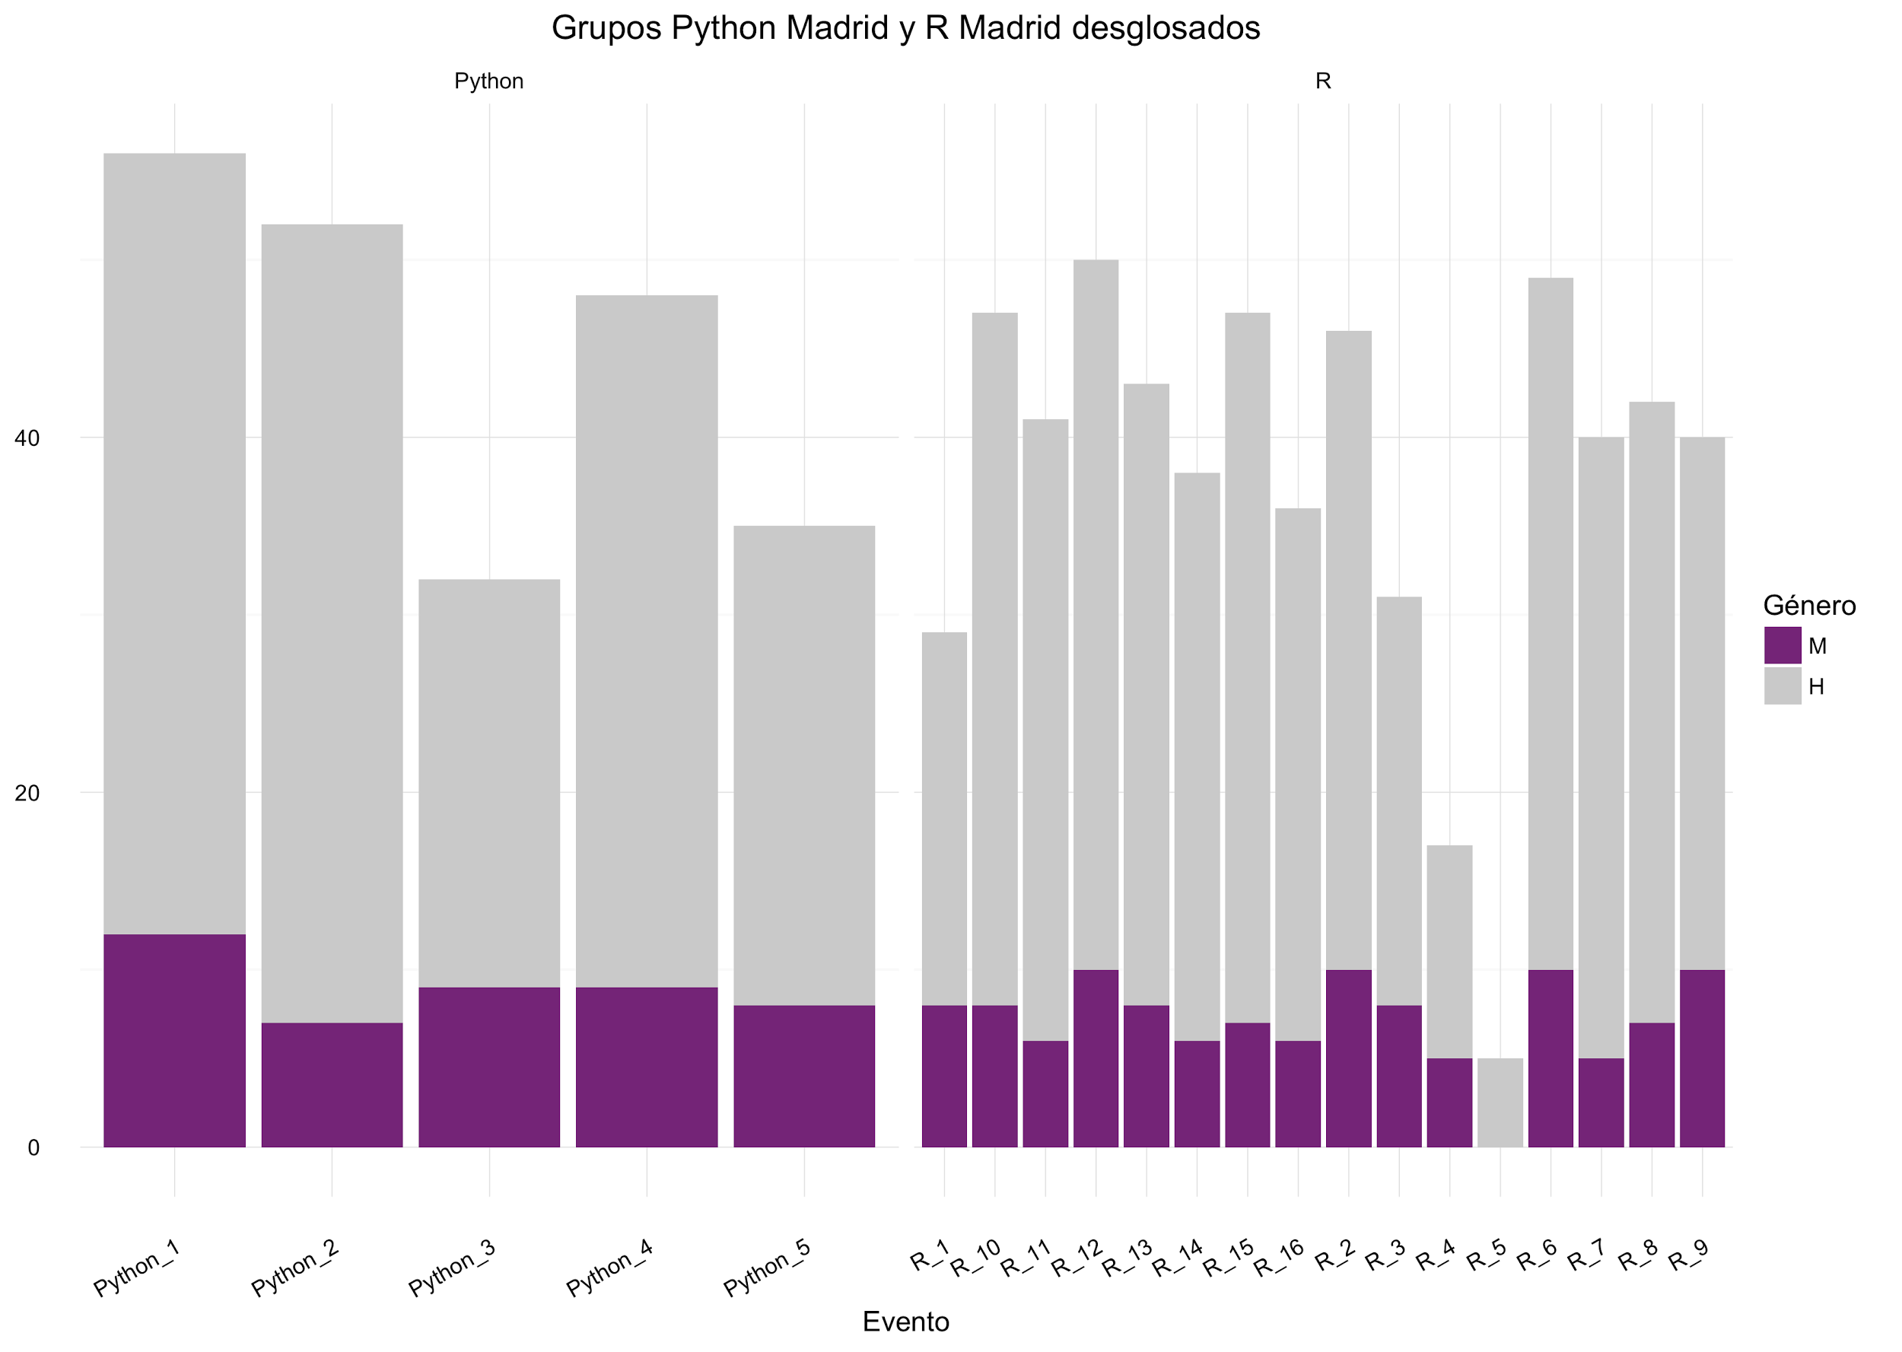
Or with ggplot2
Well, this one is a bit ugly but you get the idea.

Slide 23
89,526,124$
185,244 users
100%
That’s a lot of money
And a lot of users
Total success!

Slide 24
Our process
is easy
first
second
last

Slide 28
😉
Now you can use any emoji as an icon!
And of course it resizes without losing quality and you can change the color.
How? Follow Google instructions https://twitter.com/googledocs/status/730087240156643328
✋👆👉👍👤👦👧👨👩👪💃🏃💑❤😂😉😋😒😭👶😸🐟🍒🍔💣📌📖🔨🎃🎈🎨🏈🏰🌏🔌🔑

